Slide 1

DROPBOX SYNCING
Nanlin Zeng, Omar Popal, Alex Greco

Slide 2
Agenda
Dropbox Background
Service Scale
Networking Technologies
Potential Risk
Technology Improvements

Slide 3
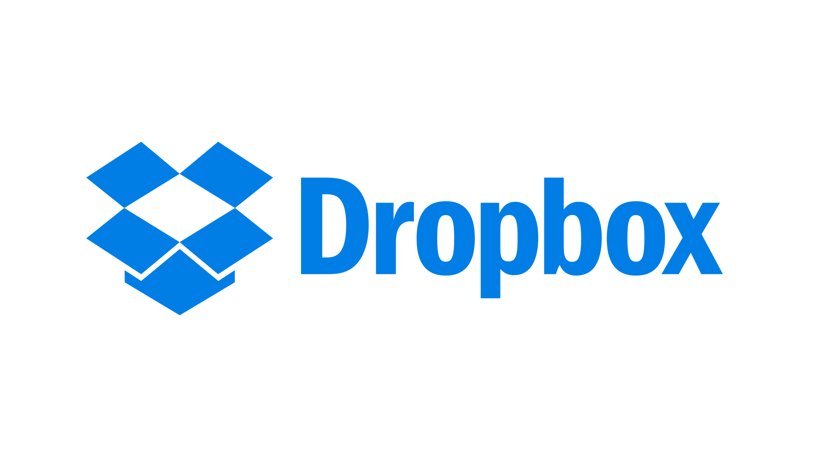
File hosting service
Cloud storage, file synchronization, personal cloud and client software
More than half a billion registered users
Notes:
Dropbox is a file hosting service founded in 2007 by Arash Ferdowsi and Drew Houston. Some of the services that Dropbox specializes in are cloud storage, file synchronization, and personal cloud and client software.

Slide 4
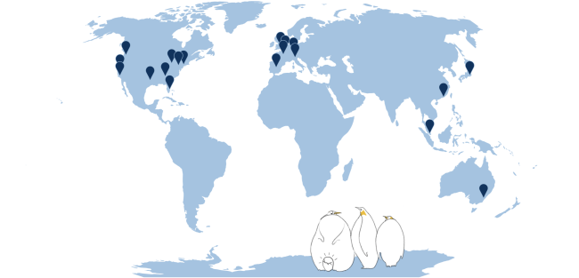
Service Scale
More than half a billion registered users
Dropbox Edge network consisting of 20 points of presence (PoPs) around the world
PoP selection is human guided but algorithm assisted
Global Server Load Balancing (GSLB)
Notes:
Currently Dropbox has more than half a billion registered users so for the company’s Traffic team this means millions of HTTP requests and terabits of traffic. To support all the requests and traffic, Dropbox has developed a network called Edge that consists of 20 PoPs around the world. The process of selecting a location for PoPs is human guided but algorithm assisted. The most important part of the Edge network is Global Server Load Balancing (GSLB). Essentially , it is responsible for loadbalancing users across PoPs. Users are sent to the PoP closest to them, unless it is over capacity or under maintenance. The reason why GSLB is so important is because if it sends users to the suboptimal PoPs, then it makes the Edge network useless and even harms performance.

Slide 5

Synchronization
Technologies
Delta Sync
Works only with modified portion
Transfers file fast
LAN Sync
Syncs files from LAN
Requires Same subnet
Streaming Sync
Reduces latency
Improves large file sync speed
Notes:
2 minutes

Slide 6
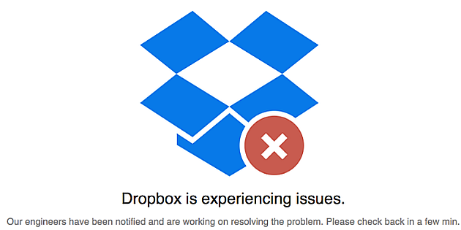
Sync Error
Notes:
1 MIN

Slide 7
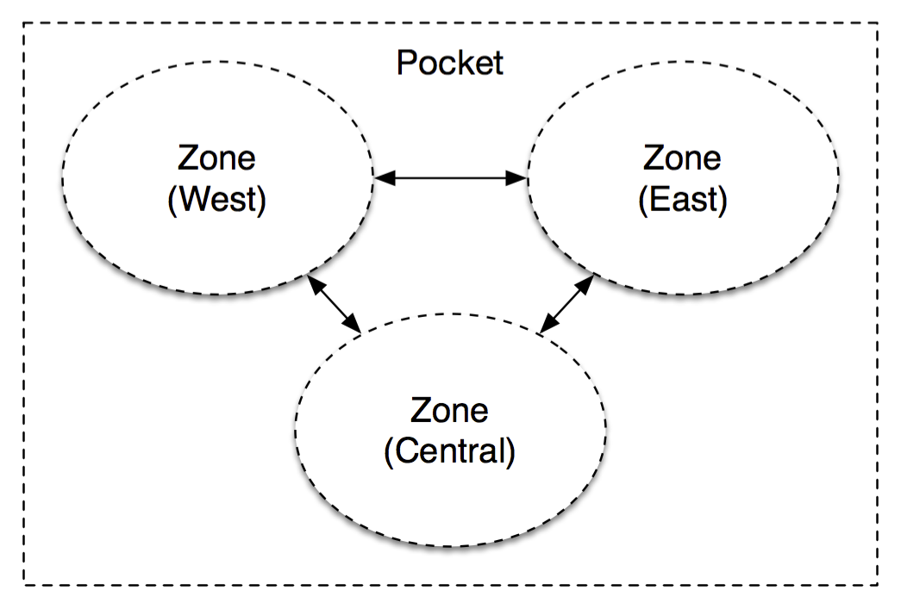
Magic Pocket

Slide 8
Technological Improvements
Dropbox Smart Sync & Dropbox Rewind
Monitoring server applications with Vortex
Dropbox Detection and Response Team (DART)
Notes:
Technology improvements for enhancing Dropbox sync performance

Slide 9
Q & A
Thank You!

